Slide 1
D-311 Unit 1: Decision Making and Situational Awareness

Slide 2
Objectives
Define situation awareness.
List six steps in the risk management decision making process.
Describe why situational awareness is important to the IADP.
List four factors that contribute to the loss of situational awareness.
Describe two ways to strengthen your situational awareness.
Notes:
Review Unit Objectives
Refer the participants to the objectives as listed in the PowerPoint slide. Allow time for the participants to review.
Present course goal and objectives

Slide 3

Situational Awareness (SA)
What is Situational Awareness?
Notes:
Situational Awareness
Situational Awareness
What is Situational Awareness?
Group Discussion
Ask the class to define situational awareness:
Situational awareness is how well your perception matches reality
If your SA is high, you have a good perception of reality.
True situational awareness occurs when an individual’s perception of reality and reality itself are the same.
Your perception does not change the reality of the situation, so you must adapt.
Discuss the situation awareness cycle – Diagram on Instructor Template

Slide 4
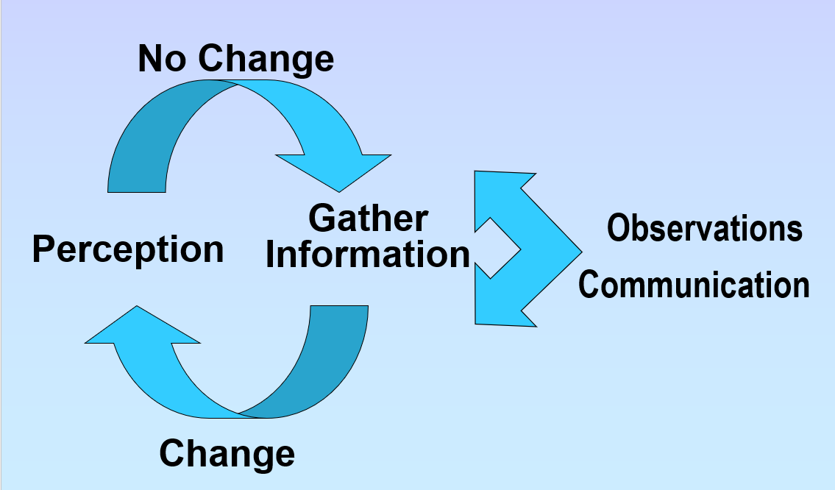
Situational Awareness (SA)
Situational Awareness Cycle
Notes:
Situational Awareness
Situational Awareness
What is Situational Awareness?
Group Discussion
Ask the class to define situational awareness:
Situational awareness is how well your perception matches reality
If your SA is high, you have a good perception of reality.
True situational awareness occurs when an individual’s perception of reality and reality itself are the same.
Your perception does not change the reality of the situation, so you must adapt.
Discuss the situation awareness cycle – Diagram on Instructor Template

Slide 5

Perception
What is Perception?
Notes:
Perception
What is Perception?
Possible Answers:
Observation
Mental image
Concept
Consciousness
A capacity for comprehension
Everyone starts with an initial perception of any given situation. Perception forms as a result of your experiences or attitudes.
When you came to this class, you had an initial perception – call it a size up. Was it going to be challenging? Interesting?
Your initial perception was only the starting point. Between then and now, you have continuously been updating your assessment – call it your perception.
You have been gathering more information and changing your mental image about the situation.
This cycle is called the situation awareness cycle, and it continues as long as you are awake and tuned in.

Slide 6


Information Gathering
What are common ways of gathering information?
Staying in communication with other dispatchers
Reading the situational report
Attend briefings
Listening
Reading weather reports
Tracking resource status
Tracking incident(s) status
Notes:
Information Gathering
The only thing that changes perception is new information.
You need to work at staying tuned in and make an effort to grab new information from an available source. Constant and conscious monitoring of the situation is required.
Understand that your perception of reality sometimes differs from reality itself.
This understanding should promote on-going questioning, cross checking, and refining or redefining of your perception.
Group Discussion
What are common ways of gathering information?
Reading weather reports
Tracking resource status
Tracking incident(s) status
Stayin in communication with other dispatchers
Reading the situational report
Attend briefings
Listening

Slide 7

Importance of SA to an IADP
Why is Situational Awareness Important to an IADP?
Situational awareness is important because it is the basis for decision making.
It is important for an IADP to strive for the most accurate perception of reality because your decisions have tremendous impacts on people, resources, and information.
Notes:
Importance of Situational Awareness to an IADP
Group Discussion
Why is situational Awareness important to an IADP?
Situational awareness is important because it is the basis for decision making.
It is important for an IADP to strive for the most accurate perception of reality because your decisions have tremendous impacts on people, resources, and information.

Slide 8
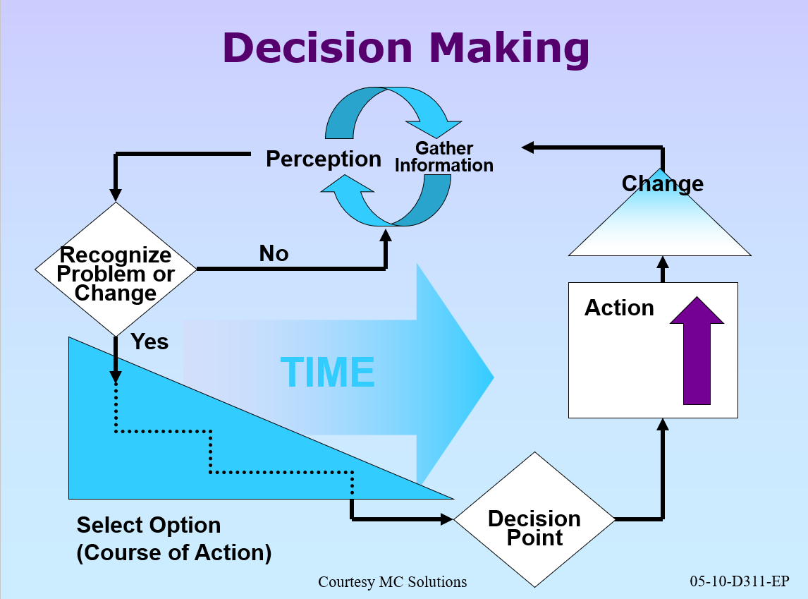
Decision Making
Notes:
If your perception of the situation is skewed, your decisions will be of little value and potentially harmful.

Slide 9
6 Steps to Decision Making
Situational awareness
Assessment
Risk control
Decision point
Implementation
Evaluation

Slide 10



Three Key Components to SA
Experience
Training
Inquiry
Notes:
Three Key Components to Situational Awareness
Experience
Discussion Points:
Gather information on most important things.
Compares the current situation to your experience.
Experienced people have more slides
Speeds up the decision-making process.
Group Discussion
40-year-old driver on slick roads vs. a 16-year-old driver.
A first-year firefighter’s approach to a fire vs a Type 1 IC’s approach.
A first-year dispatchers approach vs a center managers approach
As an IADP on assignment, you need to be aware that it takes a few shifts to build your experience base. Your situational awareness may be low in new environments.
Training
Training adds to a dispatcher’s experience file by creating events that occur in dispatch offices under controlled circumstances. It creates more mental slides.
Inquiry
To change your perspective, you need new information. To get new information you need to inquire.
Inquiry is questioning, scrutinizing, and investigating all that is happening. It is curiosity, skepticism, and interest. Inquiry is the opposite of complacency.
Dispatchers who practice questioning, scrutinizing, investigating, and being curious can gain knowledge of a situation and recognize and acknowledge their beliefs and actions can be wrong and should continuously challenge them.
Group Discussion
What does Inquiry mean?
Inquiry means respectfully being involved and helping as needed.
Lack of visual cues can be a real challenge for situational awareness due to lack of expressions, tone inflections, etc.
To compensate constantly check and double check your information.
Example: Engine 5 plots the fire over here; air attack plots it over there… this needs further investigation or inquiry.

Slide 11
Loss of Situational Awareness
Situational Awareness Traps
Low stress level
High stress level
Ambiguity
Confusion or unresolved discrepancies
Fixation or preoccupation
Departures from standard operating procedures (SOP)/regulations
Failure to meet planned targets
Ignoring gut feeling
Notes:
Factors that Contribute to the Loss of Situational Awareness
Situational Awareness Traps
Below are some traps that can take away situation awareness if you allow yourself to fall into them. Knowing they are there will help you avoid them.
Group Discussion
Low stress level
In periods of low activity situational awareness could be low due to boredom and fatigue brought on by significant decline in activity.
The lack of alertness results in the inability to react quickly and efficiently to an emergency.
High stress Level
Information overload
Personal stress
Environmental
Ambiguity
A situation in which something has more than one possible meaning and may cause confusion.
Order a heavy could mean Type 1 Helicopter or Heavy Airtanker
Confusion or unresolved discrepancies
Unclear information
Conflicting reports of fire location
Conflicting call signs
Fixation or preoccupation
Tunnel vision
Focused on one incident and not listening to the other repeaters
Departures from standard operating procedures (SOP)/regulations
Unexpected situations
Deviation from the run card
Power / radio outages
Wilderness areas
Failure to meet planned targets
Missing daily routines
Morning weather
Shift briefing
Sit report
Ignoring gut feeling
Questioning your best judgement
Recognize your own signs and trust your feelings

Slide 12


How to Strengthen SA
Anticipate
Consider Contingencies
Notes:
How to Strengthen Situational Awareness
How to strengthen Situational Awareness
Anticipate
Stay ahead of the events
Think things through ahead of time
Divide tasks and information
Consider both immediate future and the long term
Incoming weather
Short staffing
Logistics of an incident
Group Discussion
Consider Contingencies
Brainstorm a few “what if” scenarios with the students. Have someone volunteer a situation or use one of your own and work through a few contingencies with the class.
What if?
What if the helicopter has a mechanical problem and we can't get folks off the hill by dark?
What if we lose the three new starts and they go to extended attack?
All our resources are committed on the south end, what if we pop something on the north end?
Important to share your vision with your co-workers so everyone is working off the same plan.
Have students come up with contingency actions for above questions.
Sometimes things happen that cannot be anticipated. These can be accidents, system malfunctions, or simply a normal event at an unexpected time. What will you do?
Check SOP’s
Communicate your needs
Get help

Slide 13
Summary
Situational awareness is how well your perception matches reality.
It is important to the IADP because it is the basis for decision making (6 steps).
You get situational awareness by experience, training, and inquiry.
You lose situational awareness during low stress levels, high stress levels, departures from the SOP’s.
To strengthen situational awareness: anticipate, consider contingencies (“play what if”), and respond when your gut feeling says something is wrong.
Just like money, situation awareness is very hard to get and very easy to let slip away.

Slide 14
Objectives
Define situation awareness
List six steps in the risk management decision making process.
Describe why situational awareness is important to the IADP.
List four factors that contribute to the loss of situational awareness.
Describe two ways to strengthen your situational awareness.

